Slide 1

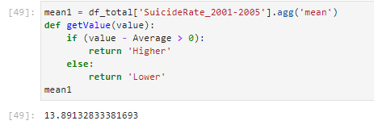



Suicide Rate Increase Result 1 – National Suicide Average Rates
1. National Suicide Average Rate during 2001~2019
2. National Suicide Average Rate in different periods
Period 1
Period 2
Period 3
Period 4

Slide 2
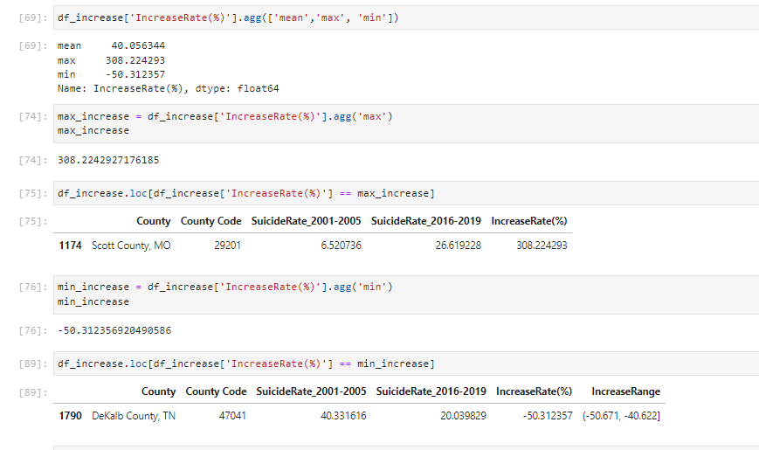
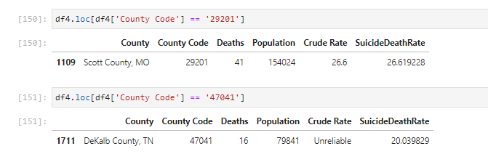
Suicide Rate Increase Result 2 – National Average Increase Rate
Comparing Period 4 to Period 1, National Average Increase Rate is 40.056%;
Comparing Period 4 to Period 1, the highest Increase Rate is 308.224293%;
Comparing Period 4 to Period 1, the lowest Increase Rate is -50.312357% (Decrease);

Slide 3
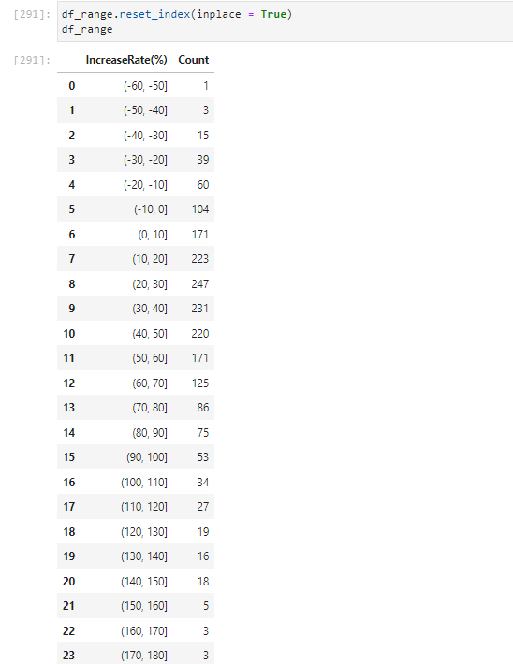
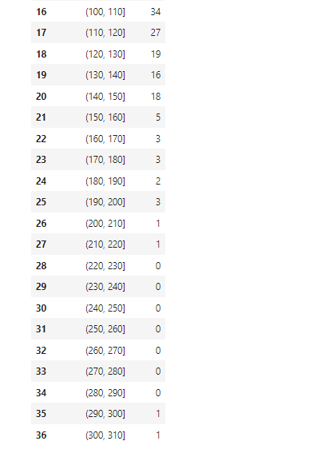
Suicide Rate Increase Result 3 – County amounts in different increase range

Slide 4
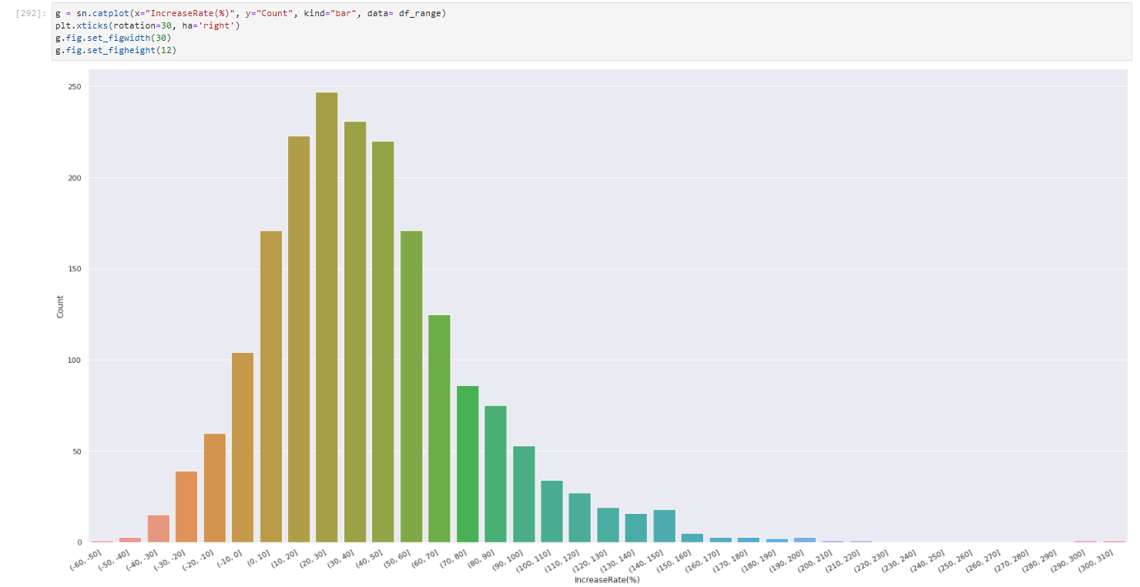
Suicide Rate Increase Result 4 – County amounts in different increase range (Data Visualization)

Slide 5
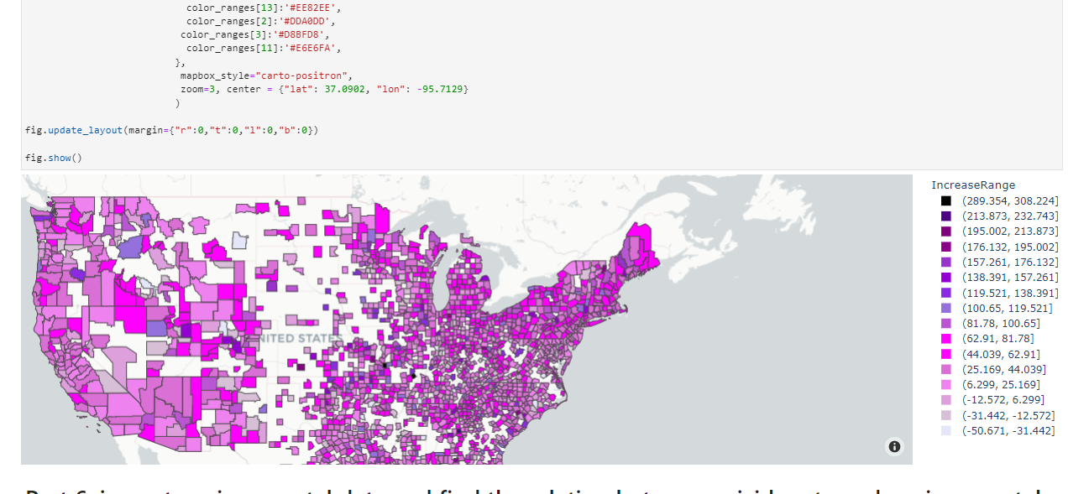
Suicide Rate Increase Result 4 – Suicide Increase Rate distributed on the map

Slide 6
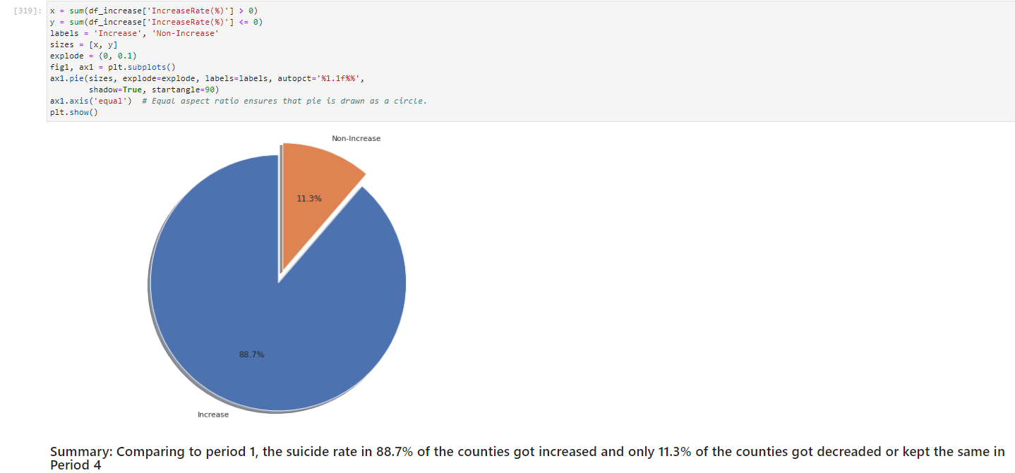
Suicide Rate Increase Result 5 – County Amount changes in different periods

Slide 7
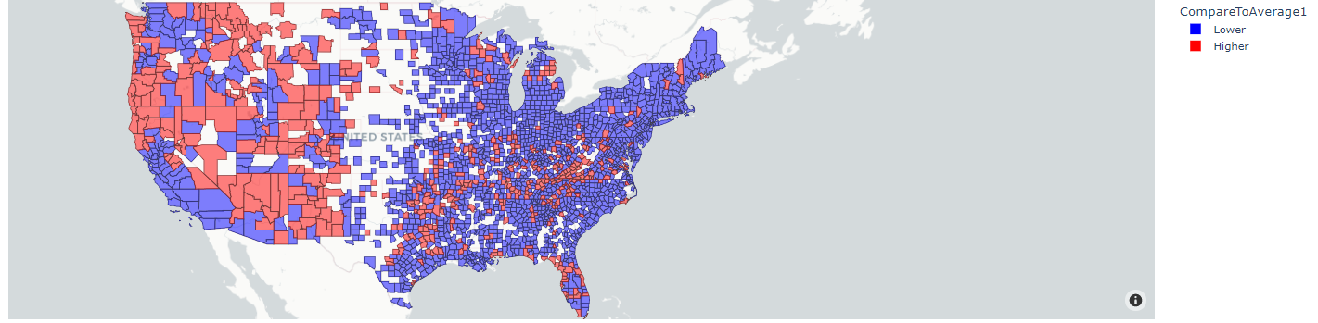
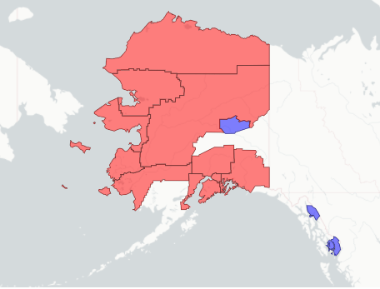
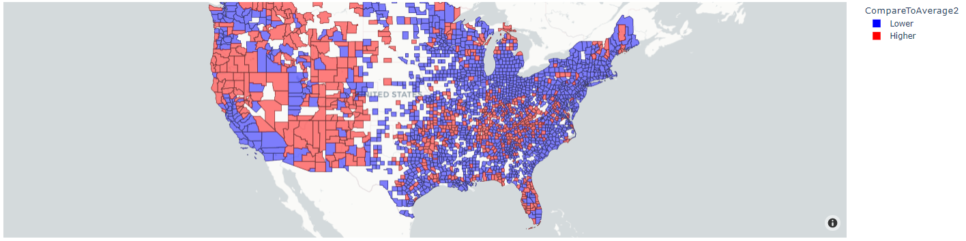
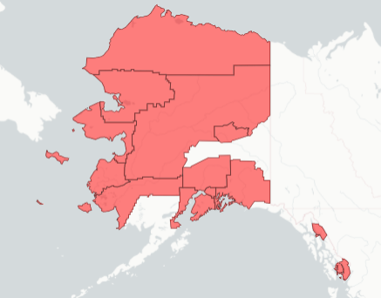
Suicide Rate Increase Result 4 – Changes on the map in period 1&2

Slide 8
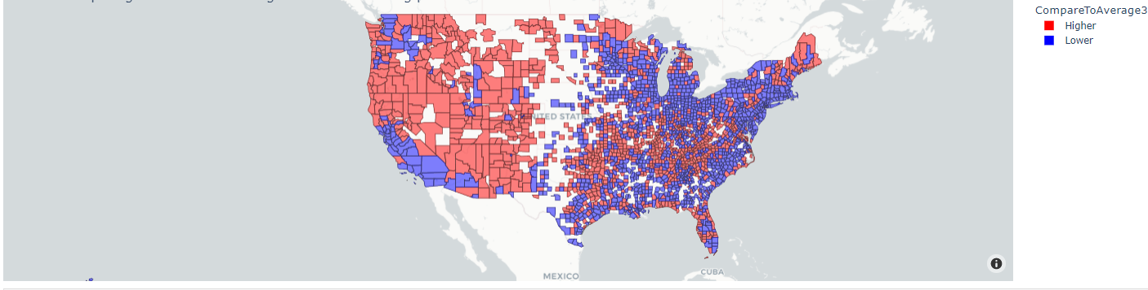
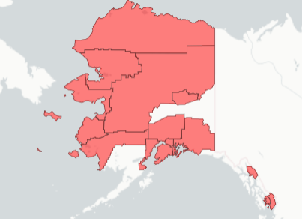
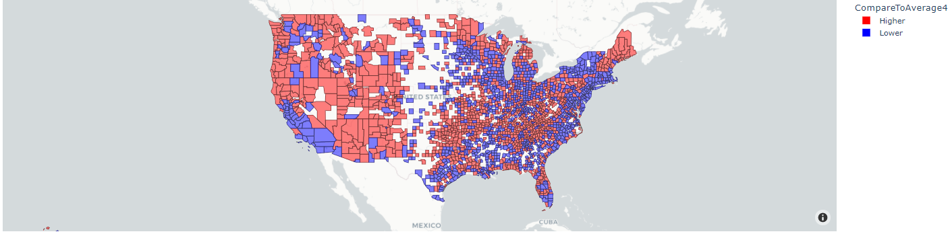
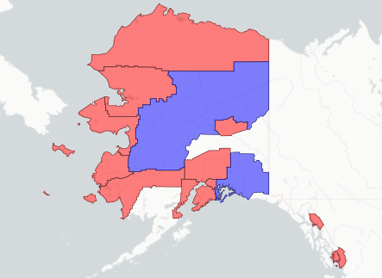
Suicide Rate Increase Result 4 – Changes on the map in period 3&4

Slide 9
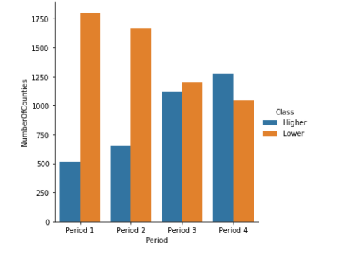
Suicide Rate Increase Result 5 – County Amount changes in different periods

Slide 10
Suicide Rate Increase Result 5
County Amount with Different Indexes in Different Periods
_{Data Index} | _{Period 1} | _{Period 2} | _{Period 3} | _{Period 4}
_{PM2.5} | ₈₅₅ | ₈₃₃ | ₈₂₃ | ₈₀₅
_{Ozone} | ₇₉₉ | ₈₂₈ | ₈₂₈ | ₈₀₅
_{SO2} | ₃₉₃ | ₃₇₀ | ₃₅₁ | ₃₅₉
_{CO} | ₂₆₈ | ₂₄₉ | ₂₁₀ | ₁₈₂
_{Suicide Death} | ₂₀₃₆ | ₂₀₉₆ | ₂₃₁₈ | ₂₁₁₃

Slide 11
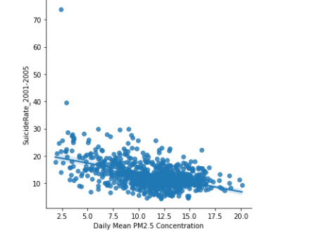
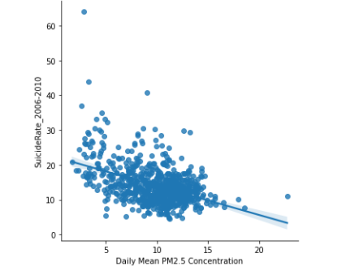
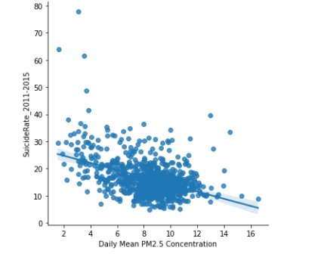
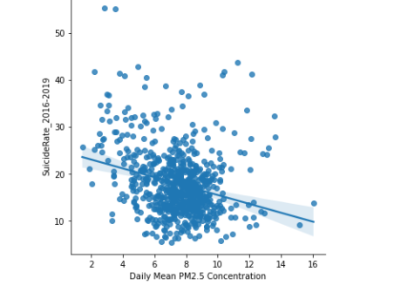
Suicide Rate Increase Result 6 – PM2.5 and Suicide Rate by Linear Regression
Period 1
Period 2
Period 3
Period 4

Slide 12
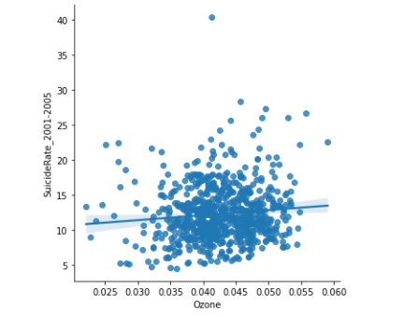
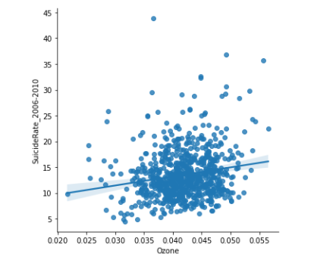
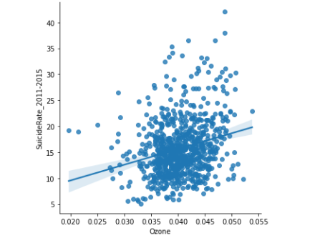
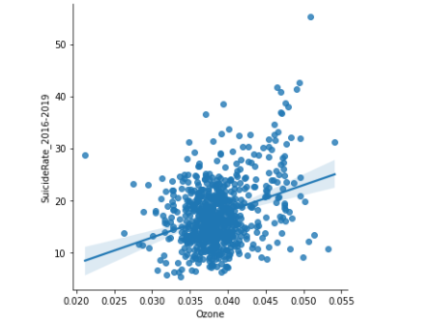
Suicide Rate Increase Result 6 – Ozone and Suicide Rate by Linear Regression
Period 1
Period 2
Period 3
Period 4

Slide 13
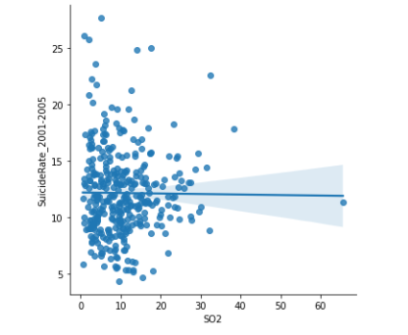
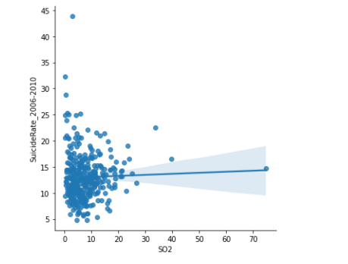
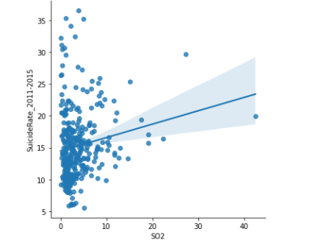
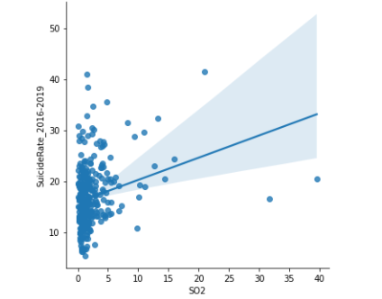
Suicide Rate Increase Result 6 – SO2 and Suicide Rate by Linear Regression
Period 1
Period 2
Period 3
Period 4

Slide 14
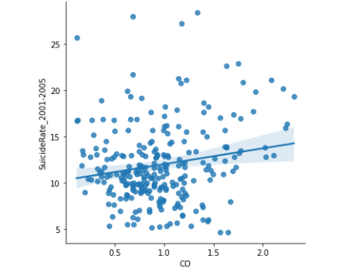
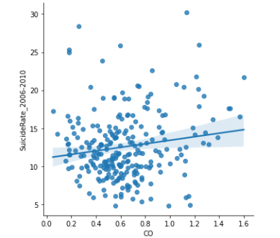
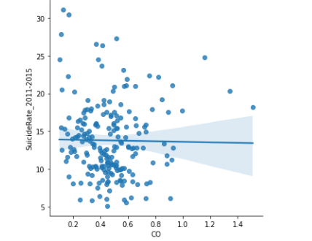
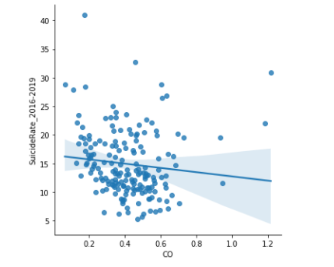
Suicide Rate Increase Result 6 – CO and Suicide Rate by Linear Regression
Period 1
Period 2
Period 3
Period 4

Slide 15
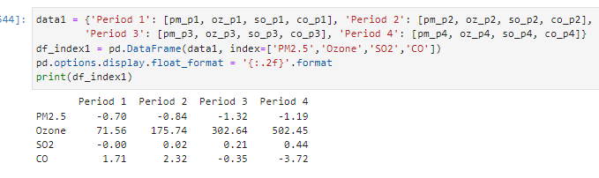
Suicide Rate Increase Result 7 – Part 1
Coefficients between single air quality index and suicide rate in different period

Slide 16
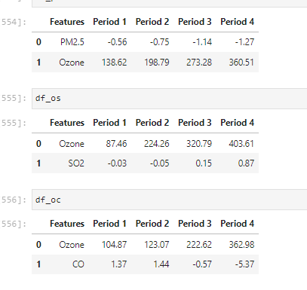
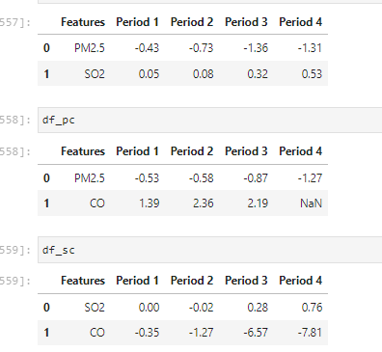
Suicide Rate Increase Result 7 – Part 2
Coefficients between any double air quality indexes and suicide rate in different period

Slide 17
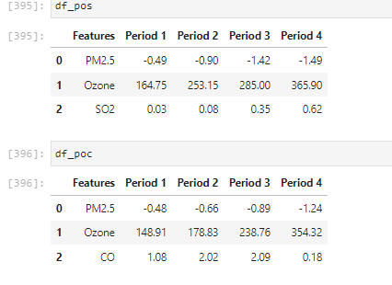
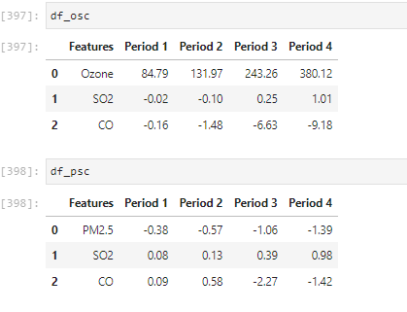
Suicide Rate Increase Result 7 – Part 3
Coefficients between triple air quality indexes and suicide rate in different period

Slide 18
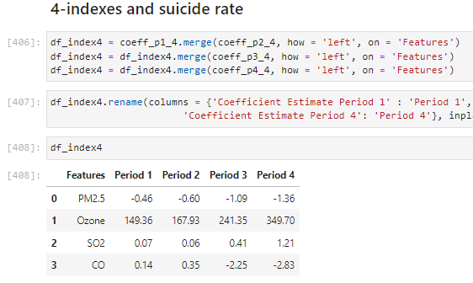
Suicide Rate Increase Result 7 – Part 4
Coefficients between four air quality indexes and suicide rate in different period

Slide 19
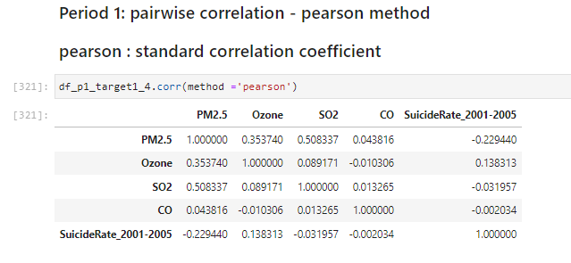
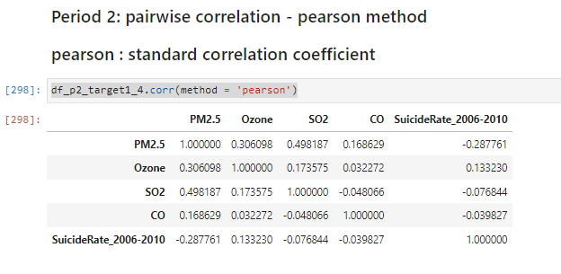
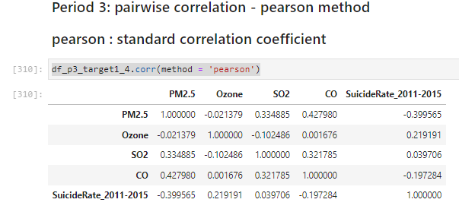
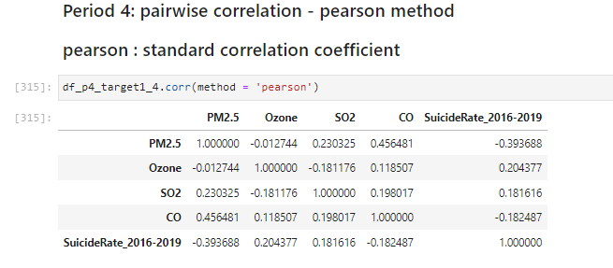
Suicide Rate Increase Result 8 – Pairwise Correlation – Pearson method

Slide 20
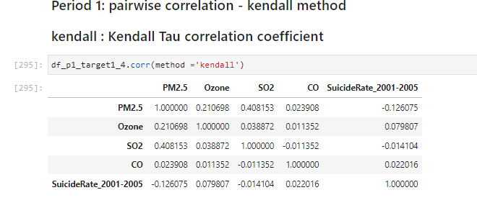
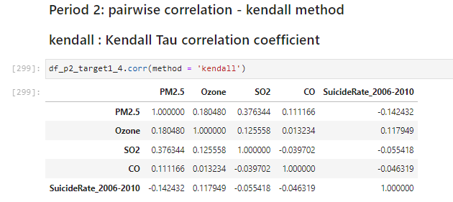
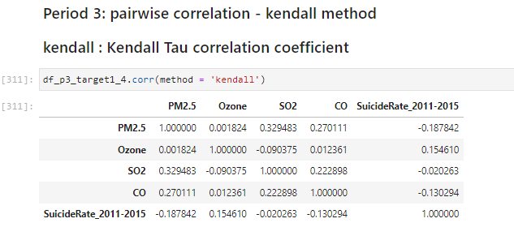
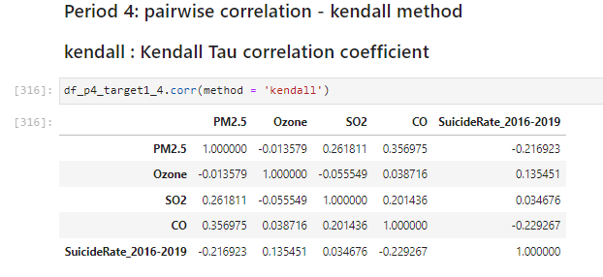
Suicide Rate Increase Result 8 – Pairwise Correlation – Kendall method

Slide 21
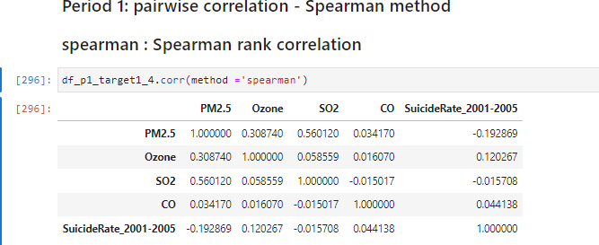
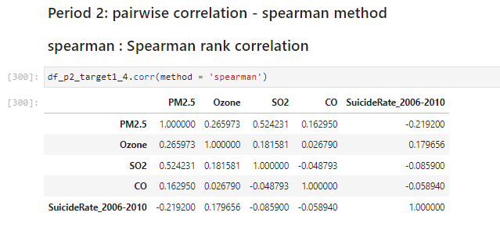
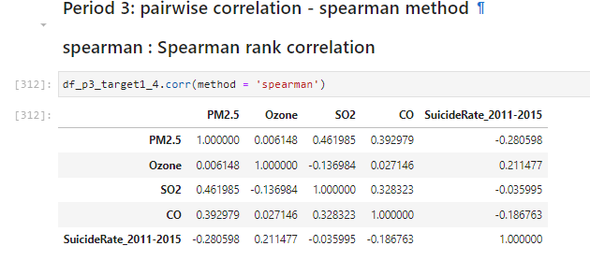

Suicide Rate Increase Result 8 – Pairwise Correlation – Spearman method

Slide 22


Suicide Rate and Temperature
1. Overall Suicide Rate and Temperature(2009&2010)
Coefficient: 0.1362
Coefficient: 0.0345

Slide 23


Suicide Rate and Temperature
2. Suicide Rate and Temperature - Male(2009&2010)
Coefficient: 0.1732
Coefficient: 0.0777

Slide 24


Suicide Rate and Temperature
3. Suicide Rate and Temperature - Female(2009&2010)
Coefficient: 0.0534
Coefficient:0.0681

Slide 25


Suicide Rate and Temperature
4. Suicide Rate and Temperature – White Male(2009&2010)
Coefficient: 0.1872
Coefficient:0.1024

Slide 26
Suicide Rate and Temperature
5. Summary of Coefficients (2009&2010)
Coefficients | 2009 | 2010
Overall | 0.1362 | 0.0345
Male | 0.1732 | 0.0777
Female | 0.0534 | 0.0682
White Male | 0.1872 | 0.1024

Slide 27


Suicide Rate and Temperature
6. Linear VS Generalized Linear(GLM) VS Elastic Net(2009)
Linear Regression
GLM regression
Elastic Net Regression

Slide 28


Suicide Rate and Temperature
6. Linear VS Generalized Linear(GLM) VS Elastic Net(2010)
Linear Regression
GLM regression
Elastic Net Regression

Slide 29


Suicide Rate and Temperature
7. Temperature and CO(2009 & 2010)
Coefficient: 0.00039943
Coefficient: -0.0004144

